Slide 1
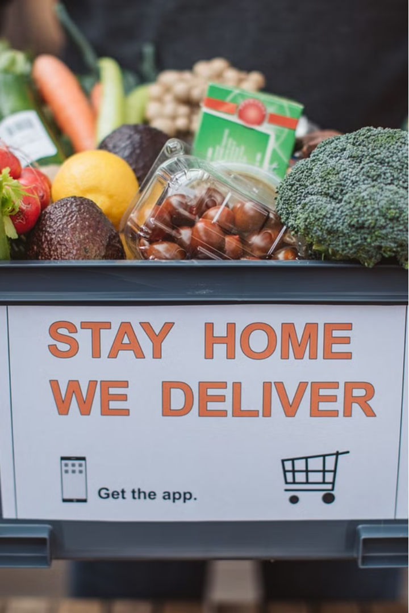
FOODPANDA 2.0
Developing a simplified food delivery platform to compete with FOODPANDA by offering lower prices.
Presented By:
Muhammad Yaseen
Riyan Rafi
Ali Abbas

Slide 2
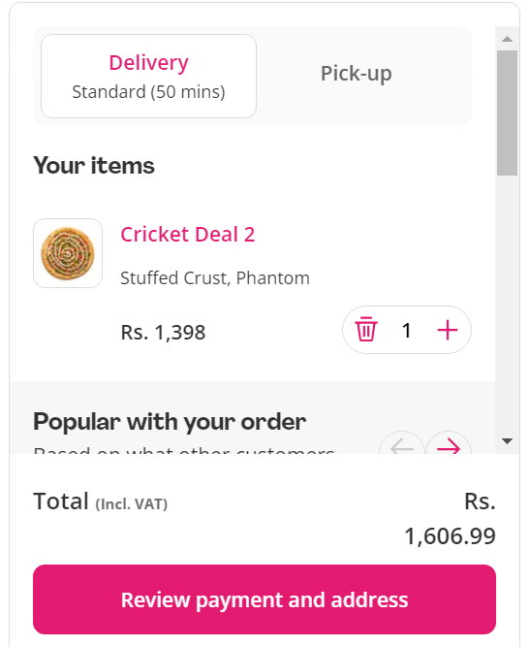

Slide 3
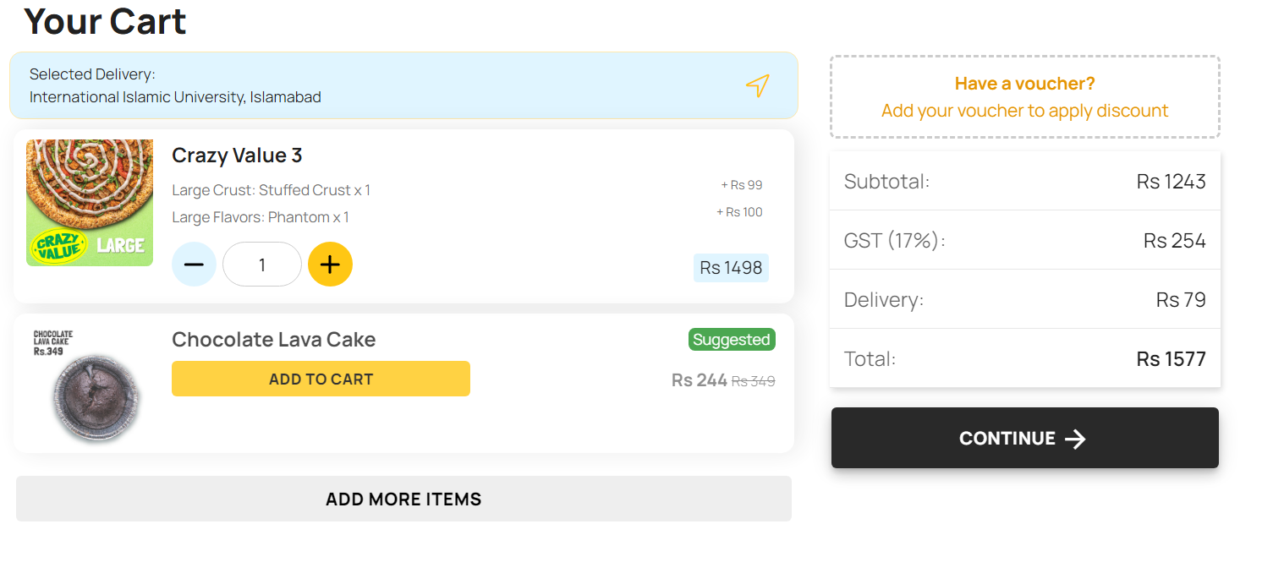

Slide 4
System Overview
Display Menu
Place Order
Display Order & Total
View available food items and prices.
Select items from the menu and place orders.
See current order and total bill before checkout.

Slide 5

Key Components
1
Menu Management
2
Order Management
Store and display food items and prices.
Track orders, calculate total bill, and display status.
3
User Interface
Simple command-line interface for user interaction.

Slide 6


Data Structures
Linked List
Structures
Manage menu items and orders efficiently.
MenuItem and Order to represent data.

Slide 7

Challenges
Input Handling
Order Management
Ensure robust input to prevent crashes.
Manage complexity of orders while maintaining data integrity.

Slide 8




Future Enhancements
User Accounts
Store order history and preferences.
Enhanced Menu
Allow filtering, sorting, and searching.
Payment Integration
Enable secure online payment options.

Slide 9

Conclusion
FOODPANDA 2.0 provides a foundational model for a simplified yet functional food delivery system.
The project demonstrates core functionalities for future expansions and enhancements.

Slide 10


